Slide 1




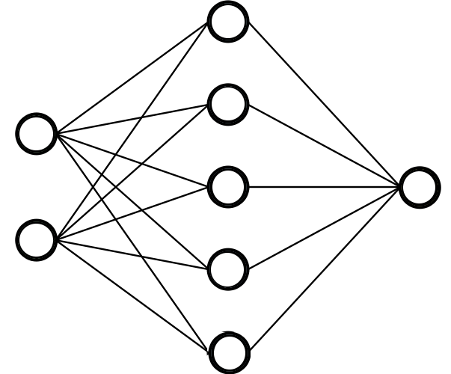

Pattern Recognition Trends & Industry
Industry Tips, Case Studies and Interview Questions
Made by Eng. Essam Wisam

Slide 2
Intended Learning Outcomes
Have a holistic view of the course topics and how they related to each other
Clarify potential next steps for further learning, such as other college courses or MOOCs.
Introduce students to the latest trends in AI, focusing on transformers and how LLMs are built using them
Familiarize students with trending LLM tools, including LangChain, and other tools.
Introduce students to HuggingFace and its applications.
Explain the hiring process and the nature of machine learning roles via actual case studies
Review real interview questions with students to prepare them for job applications.

Slide 3
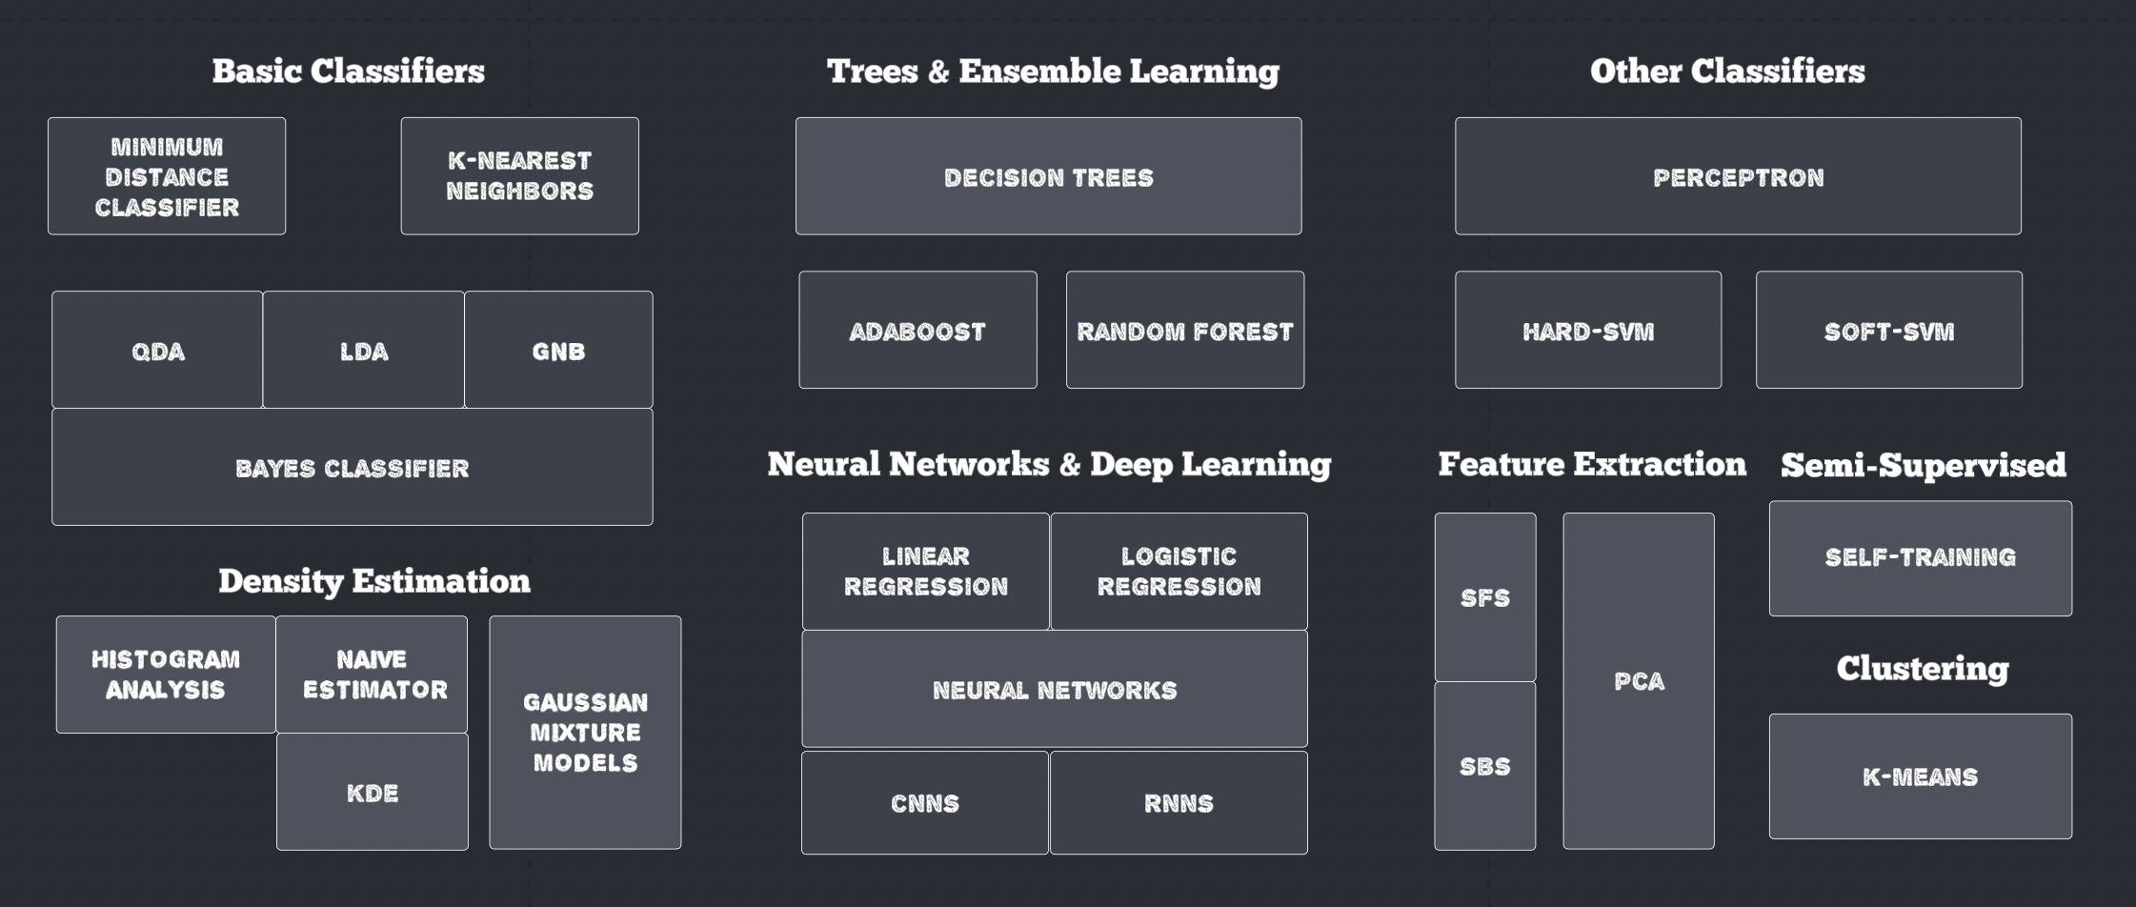
Where We At?
Algorithms Considered in the Lecture (and Tutorial) So Far:

Slide 4
Outstanding Coverage? Get’s Better
Image Processing Course: Feature extraction for computer vision and classical approaches
Machine Learning Course: Theory and mathematics behind concepts such as overfitting, validation and some models
Natural Language Processing Course: Wide coverage of machine and deep learning models where the input or output is text
Satellite Imagery Course: Great coverage of classical and deep computer vision approach (input or output images)
Data Science/Big Data Course: Classical models, table operations, deployment, statistics, etc.
Machine Intelligence Course: Classical AI (e.g., search) and Reinforcement Learning
Cognitive Robotics: Probabilistic and machine learning methods for localization and mapping

Slide 5
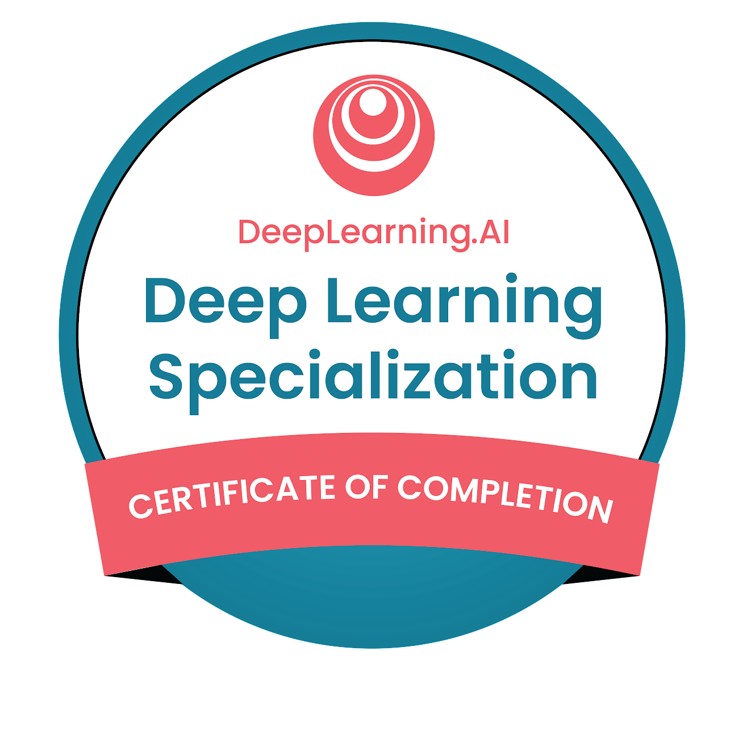
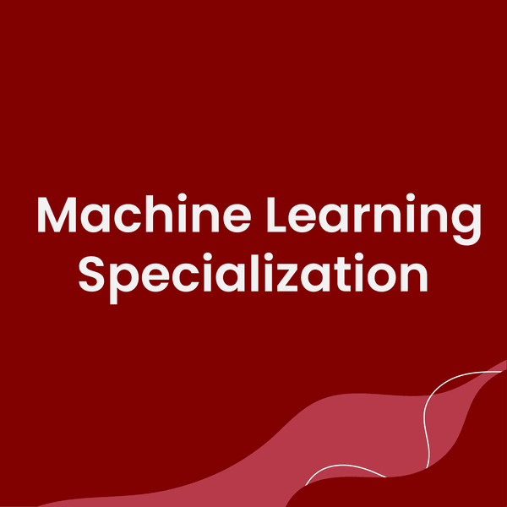
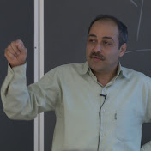
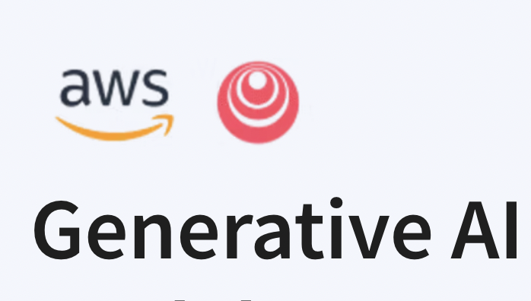
What Now?
Some MooC Recommendations
Five Courses Including CV & NLP
Ultimately Comprehensive + Many Projects
Last course on Recommender Systems and Reinforcement Learning
[Ali Ghodshi on YouTube] Great to understanding the underlying mathematics
Andrew NG Stanford ML Lectures also widely applauded
Keep up with the Generative AI with LLMs Trend

Slide 6
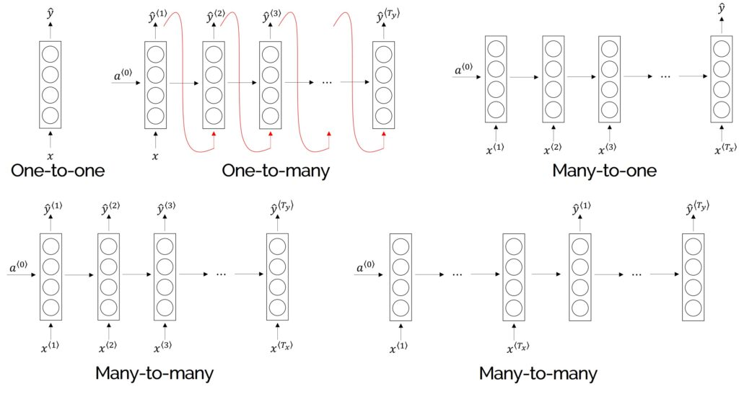
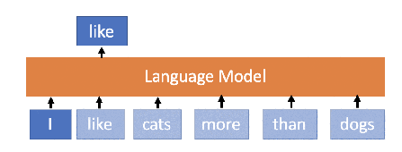
Natural Language Processing
Currently trending in AI
Fundamental Architecture: RNNs (last tutorial)
Generalize FFNN layer to input and output sequences of feature vectors
Sentiment Classification
Personal Word Masking
Text Generation = Classifier
Translation
Summarization

Slide 7

Transformer Model
One-to-one Correspondence to Encoder-Decoder RNNs
First appeared in ”Attention is all you need paper”
Majorly introduces two new blocks: attention and positional encoding
Beats RNN (and its improvements LSTM and GRU) in most if not all tasks
On the left we have the encoder (i.e., like many-to-many or many-to-one RNN)
On the right we have the decoder (i.e., one-to-many)
Authors used it for translation (hence, both are shown)
e.g., BERT
e.g., GPT
e.g., T5

Slide 8
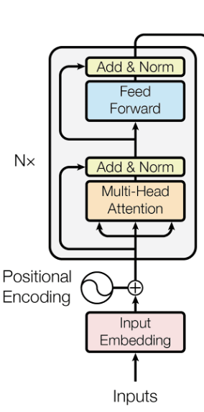
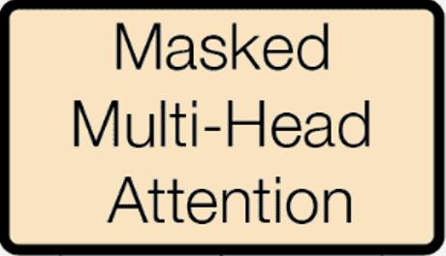
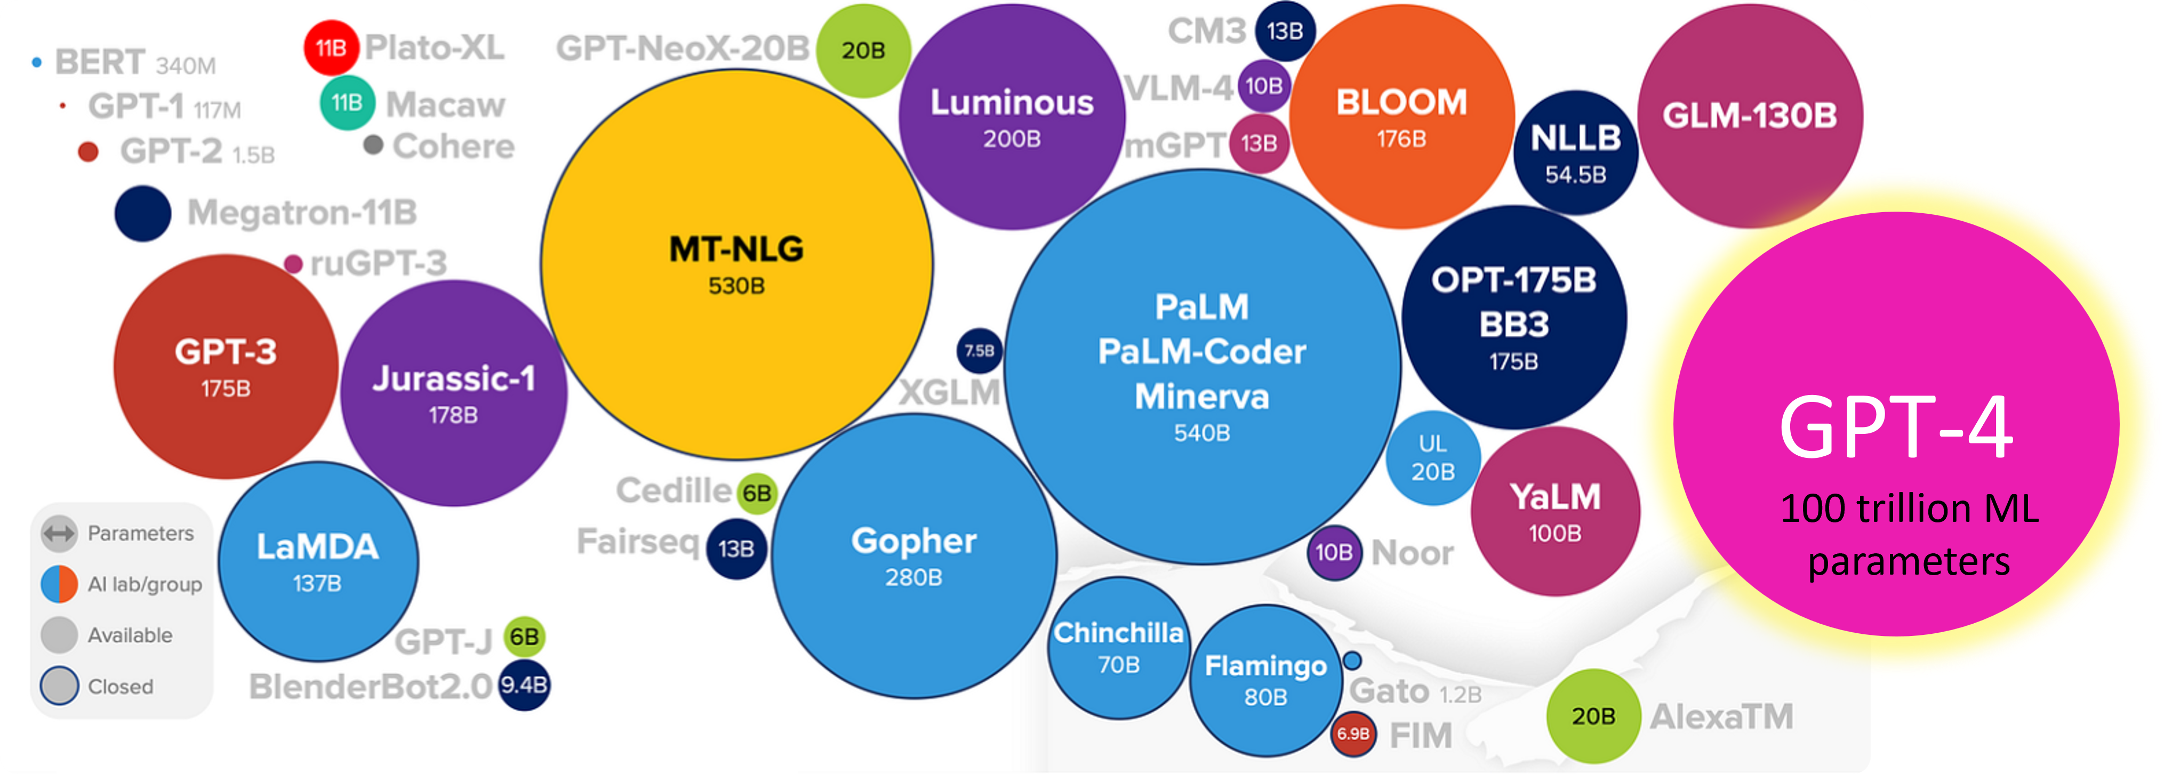
Transformer Model
Turns out transformer decoder is all you need
If you learn to utter text like humans in a wide range of different scenarios
You sound like humans when you utter text involving such scenarios
Problem: combinatorically large number of scenarios but many relationships (learn!)
If it’s trained on big enough data to capture the complexity of uttering text like humans
Model must be “large enough” to handle this (large language model)
Lambda Labs estimated that training ChatGPT on a single GPU would take 355 years. But by exploiting its parallelism, ChatGPT was trained across 25,000 GPUs
SRC

Slide 9
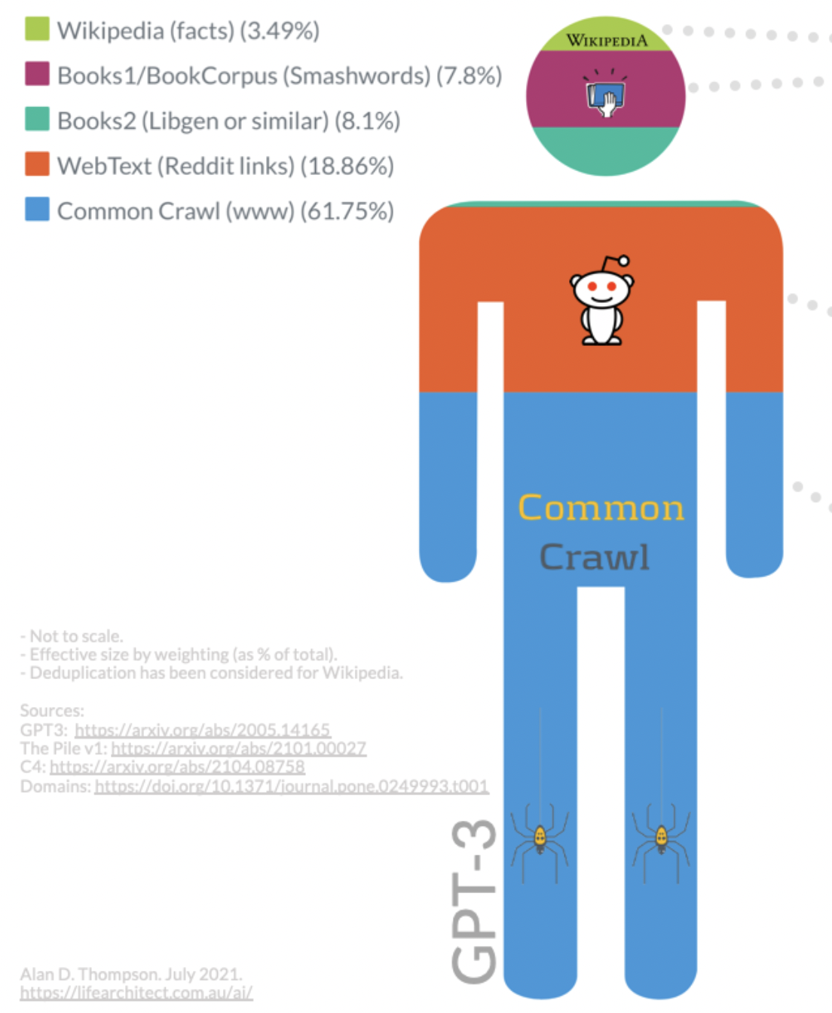
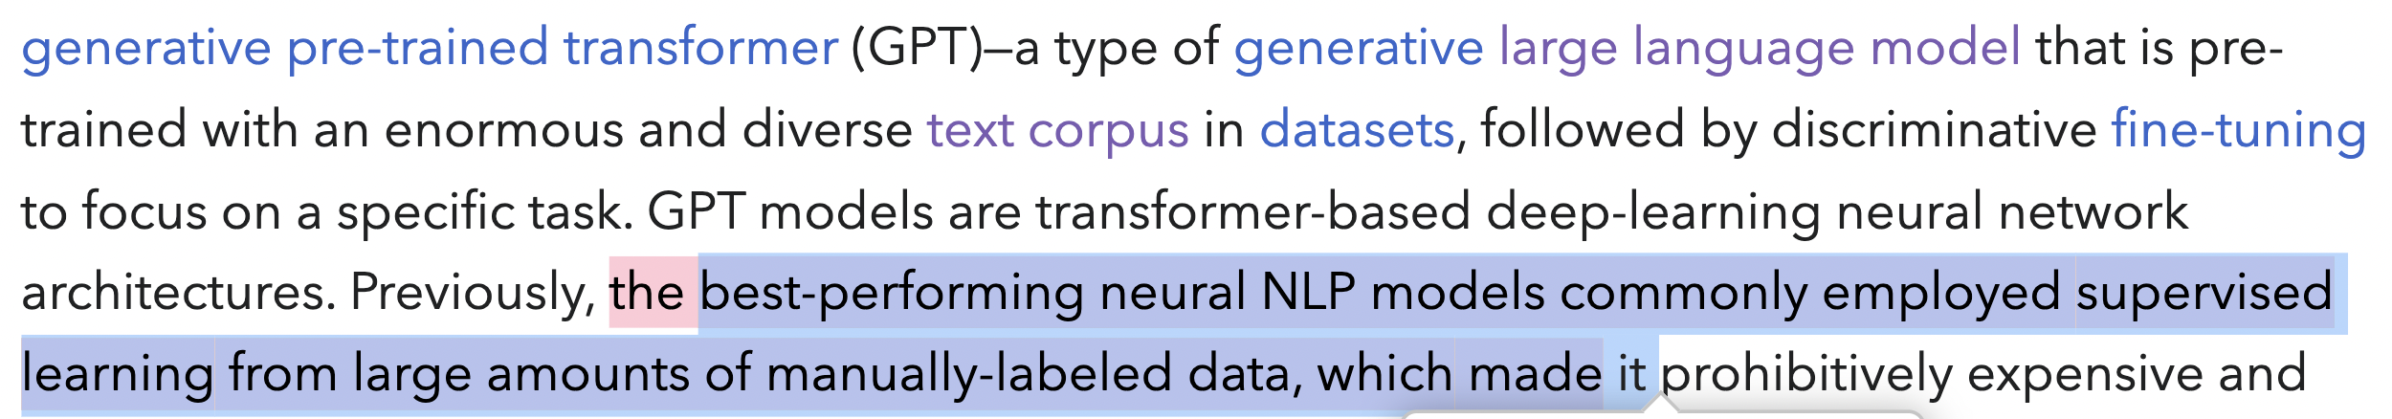
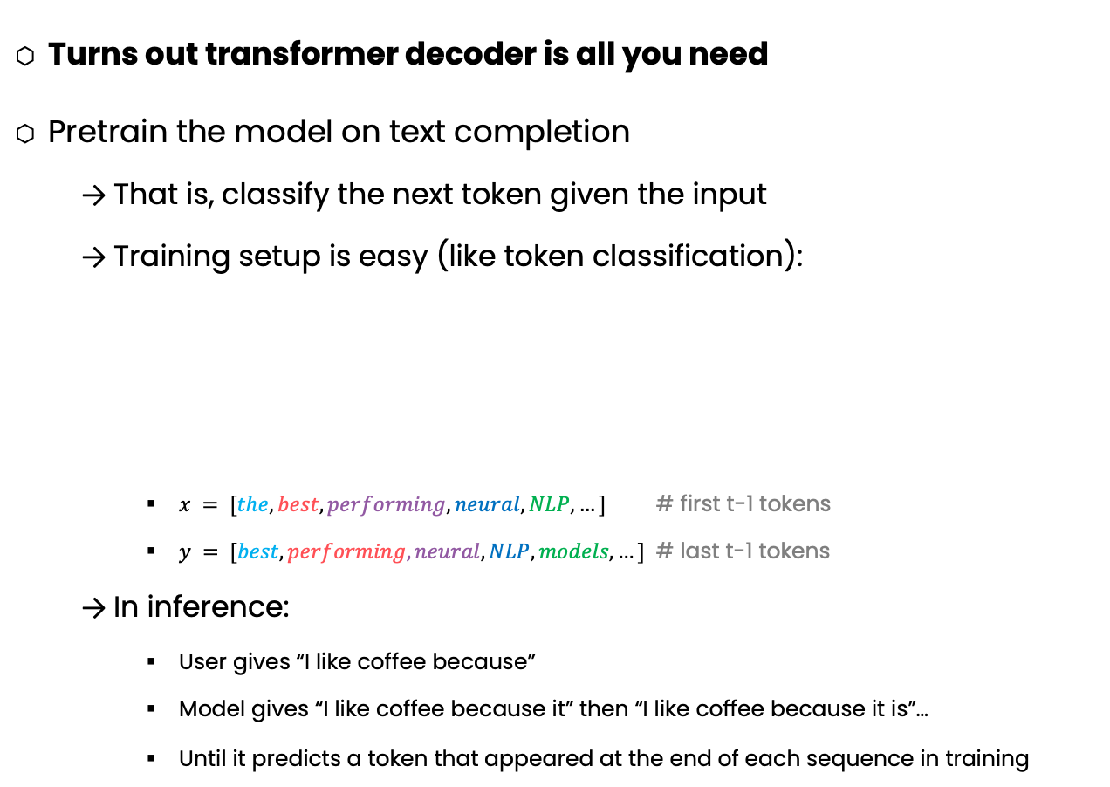
LLM Training Methodology
Turns out transformer decoder is all you need
Pretrain the model on text completion
That is, classify the next token given the input
Training setup is easy (like token classification):
$x = [the, best, performing, neural, NLP,…]$ # first t-1 tokens
$y = [best, performing, neural, NLP, models,…]$ # last t-1 tokens
In inference:
User gives “I like coffee because”
Model gives “I like coffee because it” then “I like coffee because it is”…
Until it predicts a token that appeared at the end of each sequence in training
45TB of Textual Data

Slide 10
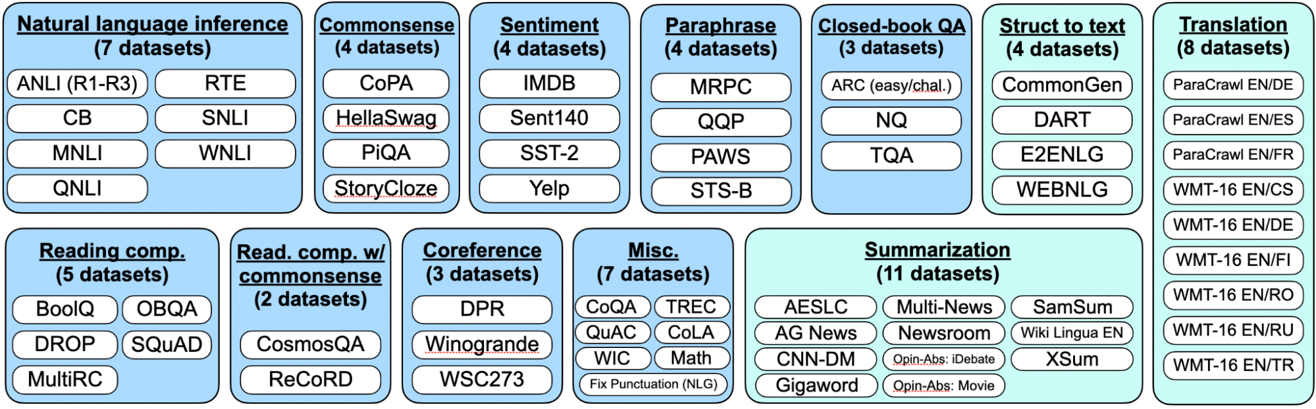
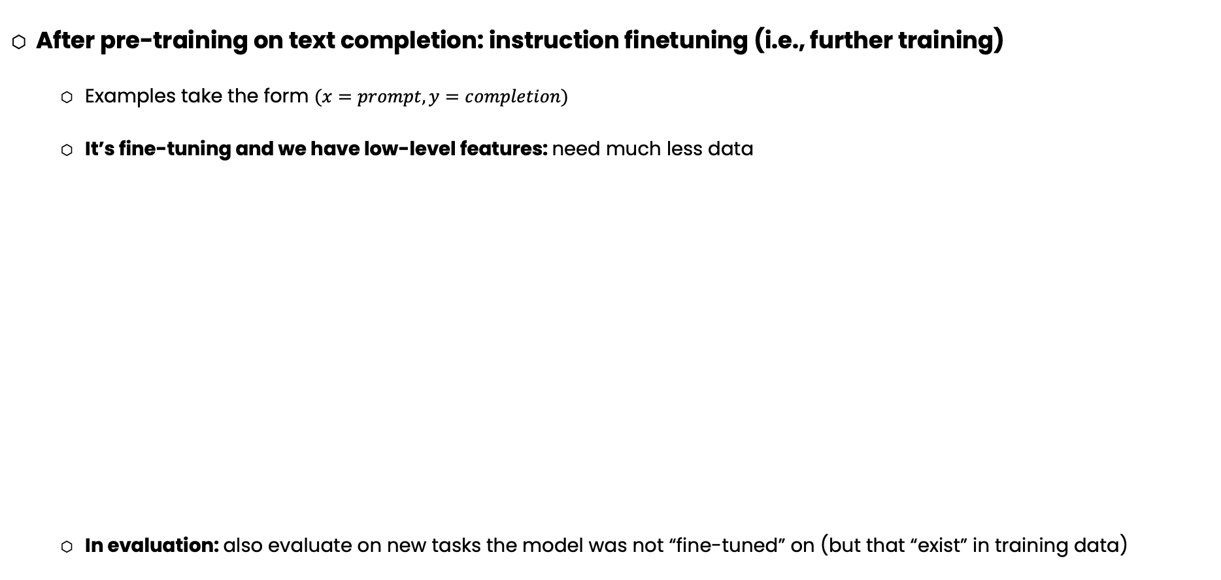
LLM Training Methodology
After pre-training on text completion: instruction finetuning (i.e., further training)
Examples take the form $(x=prompt, y=completion)$
It’s fine-tuning and we have low-level features: need much less data
In evaluation: also evaluate on new tasks the model was not “fine-tuned” on (but that “exist” in training data)

Slide 11
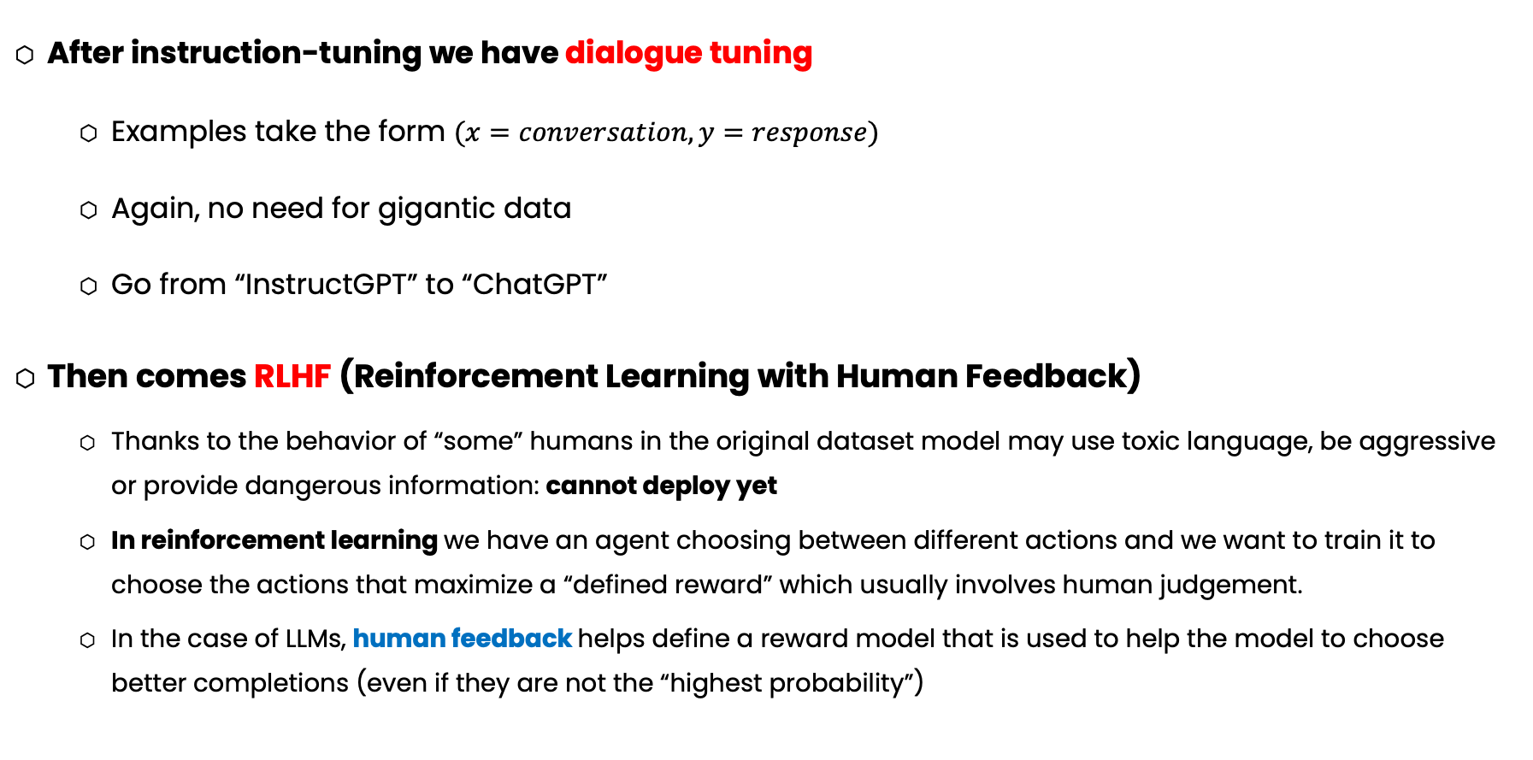
LLM Training Methodology
After instruction-tuning we have dialogue tuning
Examples take the form $(x=conversation, y=response)$
Again, no need for gigantic data
Go from “InstructGPT” to “ChatGPT”
Then comes RLHF (Reinforcement Learning with Human Feedback)
Thanks to the behavior of “some” humans in the original dataset model may use toxic language, be aggressive or provide dangerous information: cannot deploy yet
In reinforcement learning we have an agent choosing between different actions and we want to train it to choose the actions that maximize a “defined reward” which usually involves human judgement.
In the case of LLMs, human feedback helps define a reward model that is used to help the model to choose better completions (even if they are not the “highest probability”)

Slide 12
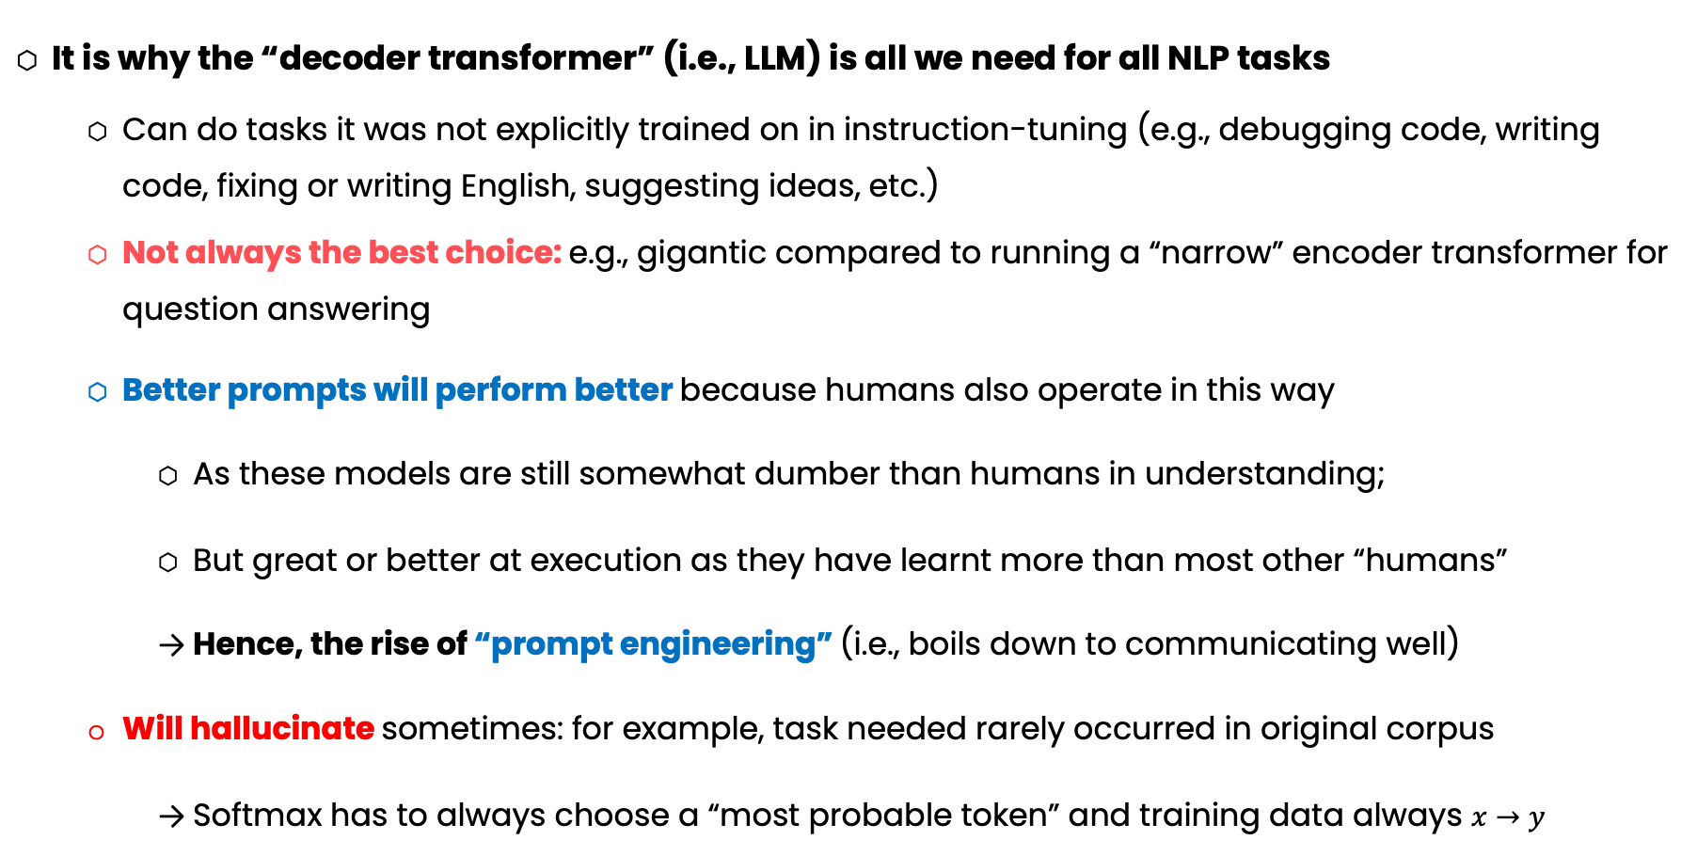
Zero-shot Learning
It is why the “decoder transformer” (i.e., LLM) is all we need for all NLP tasks
Can do tasks it was not explicitly trained on in instruction-tuning (e.g., debugging code, writing code, fixing or writing English, suggesting ideas, etc.)
Not always the best choice: e.g., gigantic compared to running a “narrow” encoder transformer for question answering
Better prompts will perform better because humans also operate in this way
As these models are still somewhat dumber than humans in understanding;
But great or better at execution as they have learnt more than most other “humans”
Hence, the rise of “prompt engineering” (i.e., boils down to communicating well)
Will hallucinate sometimes: for example, task needed rarely occurred in original corpus
Softmax has to always choose a “most probable token” and training data always $x→y$

Slide 13
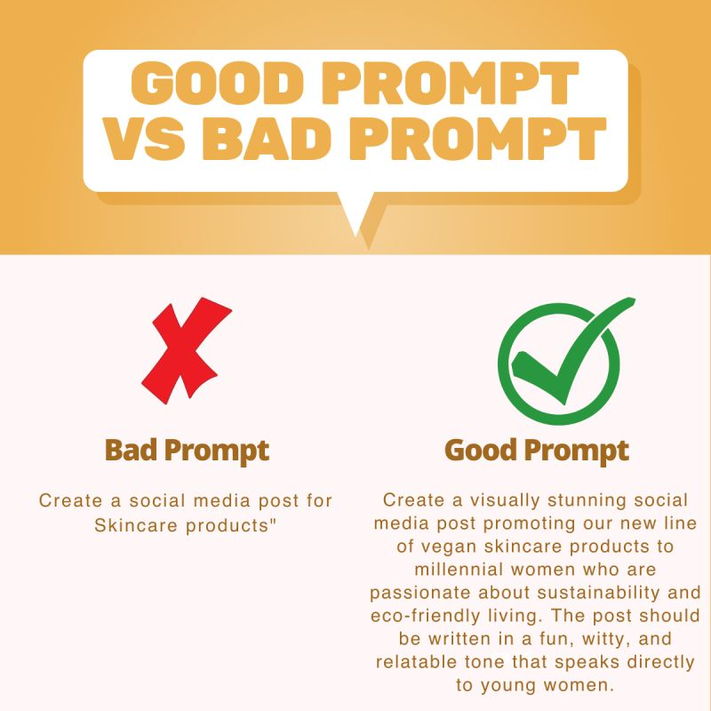
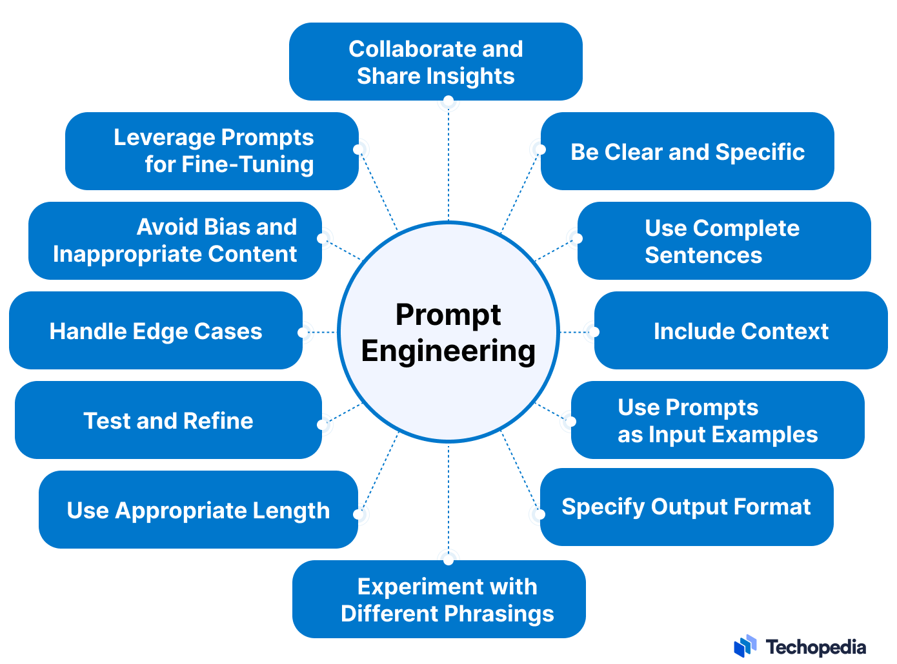
Prompt Engineering
Also known as “communicating well”?

Slide 14
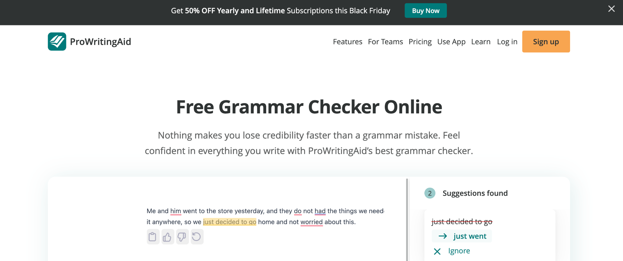
Example Startup
Not Really?
Could Take Months to Build Pre Late 2022
...
Data Collection
Training
Labeling
Tuning

Slide 15
Now: <10 Lines of Code
# 1. import OpenAI package
import openai
# 2. Set your key (it costs to use their LLM)
openai.api_key = ‘CMP20202736137324'
def grammar_check(text):
# 3. Make your prompt template
prompt_template = \
f"""Given the following text, return a json file that maps \
each grammatical error in the text (given by its index) to \
its correction: {text}"""
# 4. Given text from front-end, pass it to OpenAI
response = openai.Completion.create(
engine="gpt-3.5-turbo", prompt=prompt_template,
max_tokens=150,temperature=0.7, n=1,stop=None
)
# 5. Return LLM response (after post-process it)
return response.choices[0].text.strip()
# Example Demo
input_text = "Your input text goes here."
result = grammar_check(input_text)
Now It Takes <10 Lines of Code

Slide 16
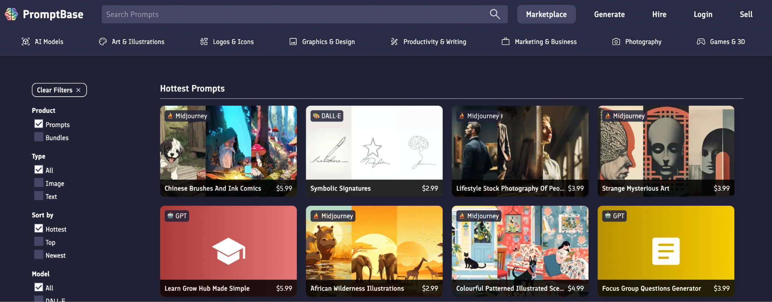
PromptBase
Buy and Sell Dall-E, Midjourney, GPT Prompts!

Slide 17
LangChain
Helps build better LLM pipelines (i.e., chains)
Generally, preprocessing, LLM call, postprocessing but also advanced features like RAG and Agents
from langchain.prompts import PromptTemplate # PromptTemplate
from langchain.llms import OpenAI # LLM
from langchain.schema.output_parser import StrOutputParser # Output Processor
# 1. Create the Prompt
prompt = PromptTemplate.from_template("Convert the following Python code to C++:\n{python_code}\n###")
# 2. Load the LLM
model = OpenAI(model_name="gpt-3.5-turbo-instruct", temperature=0, max_tokens=400)
# 3. Setup an OutputParser
output_parser = StrOutputParser() # Converts the output to string if needed
# 4. Chain them together!
chain = prompt | model | output_parser
# 5. Invoke the chain
print(chain.invoke({"python_code": "print('Hello World')"}))

Slide 18
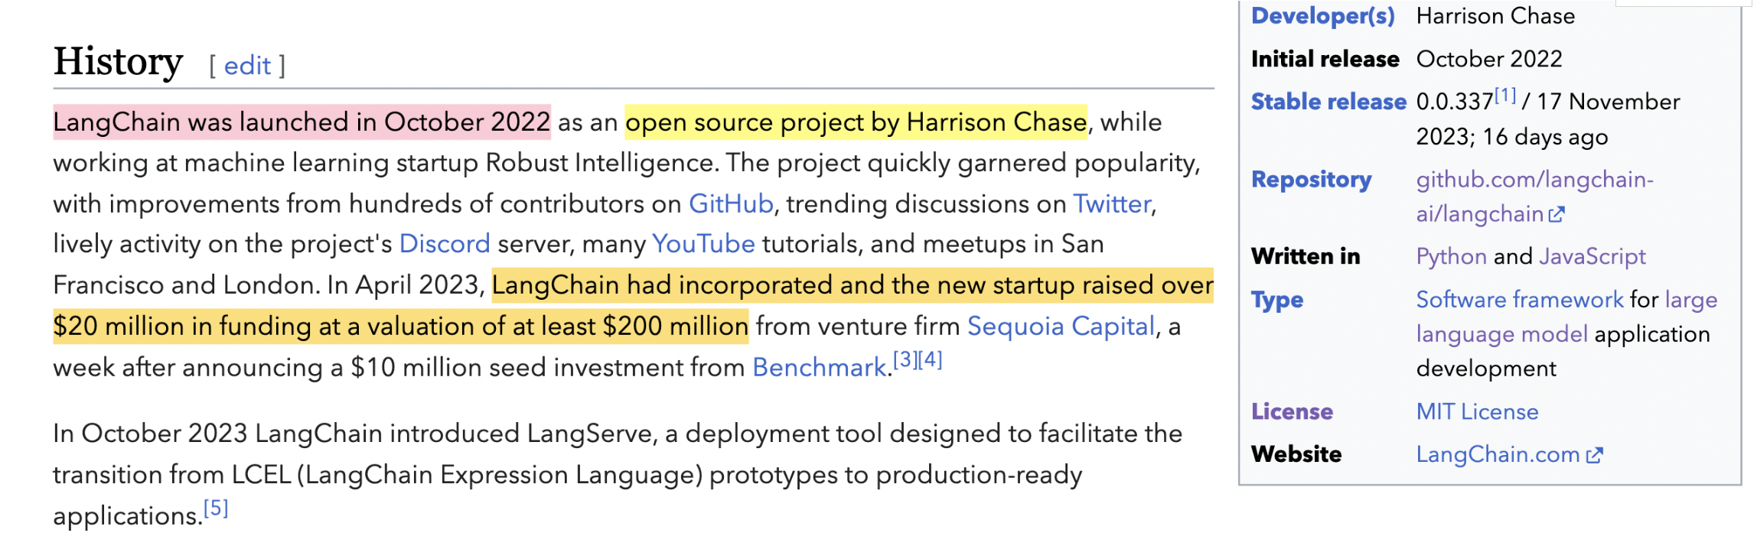
LangChain
Not impressive? First mover advantage; many LLM startups growing
Core features: chains (inc. processing and post-processing), LLM agnostic, agents and RAG
Notes:
Note that despite this many business are turning away from LangChain because it’s not that flexible or stable and it’s not hard to implement the base functionality from scratch (still the most well known LLM pipeline library which is why you have to know about it)

Slide 19
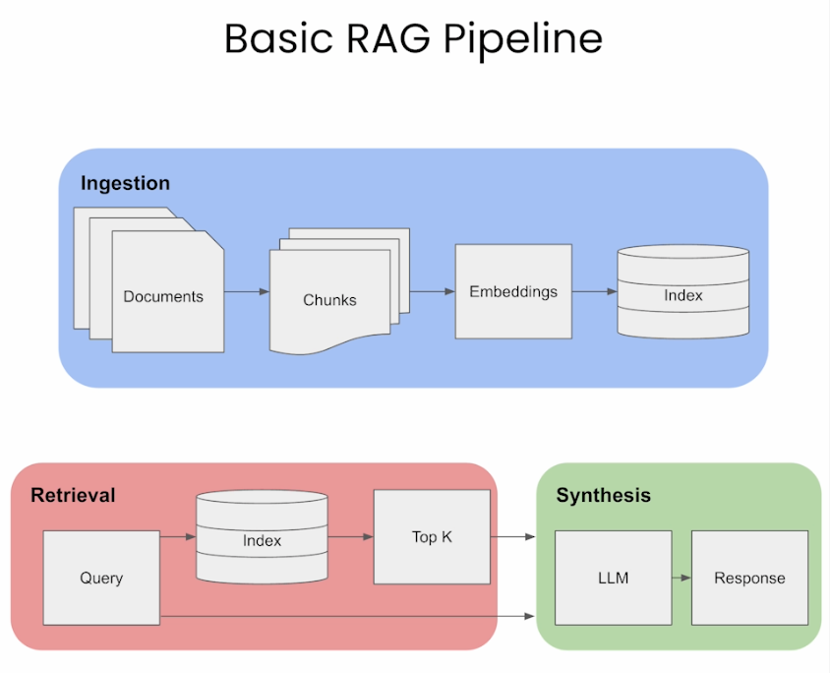
LangChain: RAG
Problem Statement: Want “grounded” LLM responses and no hallucination
Extra block (in red) introduces an extra textual section to the prompt
Use basic NLP technique to find that section (e.g., sentence similarity)
More efficient/performant that inputting the whole resource (e.g., book)
Reference

Slide 20
LangChain: RAG
Problem Statement: Want “grounded” LLM responses and no hallucination
# 2. Declare the Model
llm = OpenAI()
# 3. Define a custom function to concatenate the chunks
def format_docs(top_k_chunks):
...
# 0. Setup Retriever
retriever = ...
# 1. Prepare prompt
template = """Use the following 3 pieces of context to answer the question at the end.
Use three sentences maximum and keep the answer as concise as possible and be honest and say I don't know when you need to.
{context}
Question: {question}
Helpful Answer:"""
prompt = PromptTemplate.from_template(template)
# 4. Declare the RAG chain
rag_chain = (
{"context": retriever | format_docs, "question":RunnablePassthrough()}
| prompt
| llm
| StrOutputParser()
)
# 5. Use the RAG chain
rag_chain.invoke(”Who was the first king of Egypt?")

Slide 21
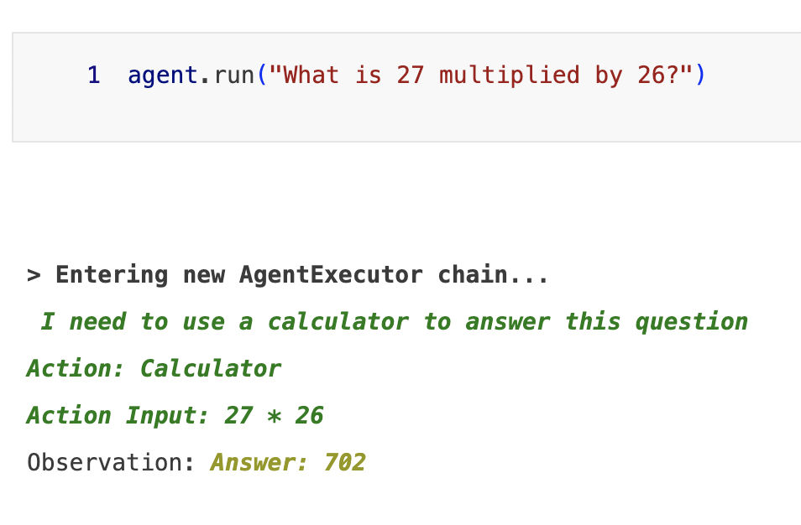
LangChain: Agents
Problem Statement: Want LLMs to be able to call tools and use output from them!
# 1. Define the tools (some need LLMs; e.g., math)
tools = [
Tool(
name = "Search",
func=SerpAPIWrapper().run,
description="useful for current event questions"
),
Tool(
name="Calculator",
func=LLMMathChain(llm=OpenAI(temperature=0)).run,
description="useful for math questions",
return_direct=True
),
Tool(
name="Music Search", # Custom dummy tool
func=lambda x: ”Example Song.",
description="A Music search engine
)
]
# 2. Define LLM
llm = OpenAI(temperature=0)
# 3. Wrap tools and LLM in an agent!
agent = initialize_agent(tools, llm, agent="zero-shot-react-description", verbose=True)

Slide 22
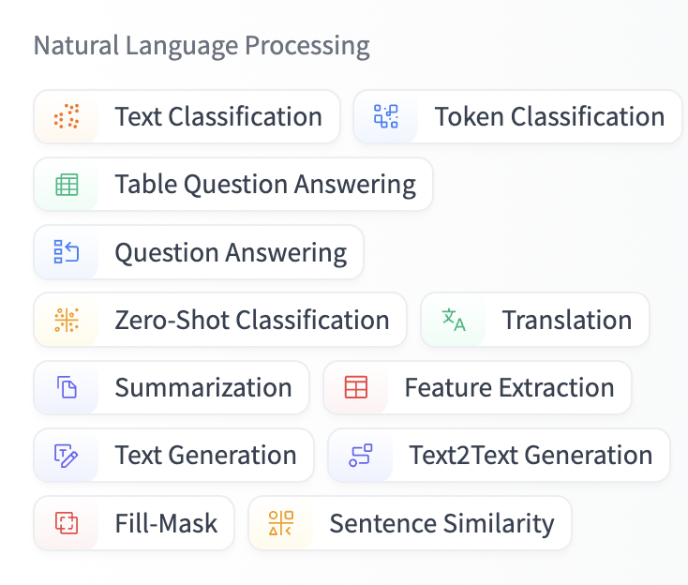
Back to NLP: HuggingFace
For many problems, using a generic LLM could be too expensive and it’s better to use a smaller model (encoder or encoder-decoder)
🤗 HuggingFace (package and website) houses a large range of pretrained NLP (and CV) models
Usually get pretrained model then fine-tune it on a custom task
As we saw before for CV, much better that training from scratch
Let’s have a real demo by navigating to their website.

Slide 23
Back to NLP: HuggingFace
For many problems, using a generic LLM could be too expensive and it’s better to use a smaller model (encoder or encoder-decoder)
🤗 HuggingFace (package and website) houses a large range of pretrained NLP (and CV) models
Usually get pretrained model then fine-tune it on a custom task
As we saw before for CV, much better that training from scratch
Let’s see their website.
Models are in PyTorch/TensorFlow (mostly PyTorch) so no need to learn new syntax (just some high-level functions)

Slide 24
HuggingFace Example
import torch
from transformers import DistilBertTokenizer, DistilBertForSequenceClassification
tokenizer = DistilBertTokenizer.from_pretrained("distilbert-base-uncased-finetuned-sst-2-english")
model = DistilBertForSequenceClassification.from_pretrained("distilbert-base-uncased-finetuned-sst-2-english")
inputs = tokenizer("Hello, my dog is cute", return_tensors="pt")
with torch.no_grad():
logits = model(**inputs).logits
predicted_class_id = logits.argmax().item()
model.config.id2label[predicted_class_id]

Slide 25








ML Industry in Egypt
Certainly Not Comprehensive
Let’s learn more about the ML industry through some case studies

Slide 26
Case Study: Ejada
Software Engineering Firm in General
Headquartered in Riyadh and is located near Heliopolis/Smart Village in Egypt
Hybrid work format: at least two days in the office
Example ML Work: NLP, time series and classical machine learning
Hiring Process:
Submit CV
Pass online MCQ technical exam + two easy coding problems about general software engineering (OOP, SQL, Web, etc.)
After few weeks from passing conduct technical interview
Then behavioral interview
Includes: discussing previous ML projects, GP, basic ML questions (overfitting, regularization, cleaning)
Notes: they didn’t go into much detail (more about breadth)
Only time series was out of scope relative to college
Receive job offer after about a month

Slide 27
Case Study: Ejada
Problem Solving Needed: Nope
Projects similar to college: Yes, but more emphasis on validation, testing and quality/docs
Observed that masters/PhD implies an advantage: Yes, more senior positions
Some resources/Tips:
San foundry questions for the MCQ
Recap on college ML courses and online interview questions (including behavioral)
Get used to ML reading papers as well as ML basics (try to do it frequently)
Get used to generative AI/NLP terminology as it’s a hot field (on demand)

Slide 28
Case Study: Dstny Engage
Chatbot-as-a-service
Headquartered in Europe and previously bought Tactful AI (Egyptian) but now separated
Fully remote is okay
Internships (e.g., during college) can later translate into fulltime offers
Hiring Process:
Submit CV
Technical interview
HR interview (behavioral)
Includes: discussing previous ML projects as well as technical software engineering and ML questions (not hard at all)
Software engineering was a little out of scope compared to college

Slide 29
Case Study: Dstny Engage
Problem Solving Needed: Nope
Projects similar to college: Yes, but more emphasis quality/docs
Friend was writing same code for NLP project and project at Dstny
Another example: NER to hide personal tokens in a message and question-answering
Observed that masters/PhD implies an advantage: Not really but we agree there is an advantage
Some resources/Tips:
Andrew NG courses are great
“Focus on basics, most of the company ask about basics, basics of mathematics and basics of Machine Learning Algorithms, the advanced topics can be learnt inside the company.”
Try to pretend more often that your ML college projects will be seen by HRs
Make a list of things you want to learn and practice with coarse scheduling plans

Slide 30

Case Study: Bright Skies
Bright Skies works in automotive and HPC
Fields involved: deep learning techniques for 2D and multi-view images and robotics (tracking, mapping, etc.)
Hiring Process Example:
Submit CV + Recommendation + Technical Interview
They asked about each bit in the CV (different projects and internships) and for some of them in details (to the decision level)
Knowledge gaps compared to CV via deep learning as covered in college (needed to go beyond that)
Problem Solving: Nope
Masters or PhD useful: Yes, many job posters have masters as a minimum. Ideally, should aim to get it from abroad. Senior colleagues had or sought masters and advised for it.

Slide 31

Case Study: Bright Skies
Resemblance with College Projects: Somewhat, except that there is no longer a way to not be serious (e.g., reading papers and finding approaches)
“Not really as, problems in real life like data scarcity, transfer learning, augmenting too much because of small data but leading to overfitting at the end, lack of resources, finding resources but in Chinese (literally), taking a working model from a library…”
Useful Resources and Tips:
“Try to implement from scratch as many papers as possible, you can follow Aladdin person projects where he implemented yolo,unet, GANS, attention from scratch, it's really helpful and will make you know you weak points”
Use ChatGPT to generate interview questions
Catch up with papers and implementations from scratch: see https://www.youtube.com/c/AladdinPersson and https://www.youtube.com/@YannicKilcher
Case Study: Atomica AI
CV then technical ML interview but also coding a for loop in C++
Assumed knowledge of popular CNN architectures and 3D vision concepts
Questions also involved data structures and algorithms (e.g., BFS/Connected Components) as technique need it
Real-life project: highly optimized CAD tool for dentists powered by AI (tough for DL) and involved 3D CNNs, UNET and etc.

Slide 32
Case Study: DELL
Located in New Cairo and its not only specific to ML
Has an annual Hackathon “Hacktrick” (great learning and networking experiences whether you win or not)
Hybrid work format (at least n days in office for some small n)
Example work field for ML: use machine learning and data handling for 5G/Telecom related issues
Example workload includes reading papers, benchmarking models and wrangling with data.
Hiring Process (~3 months):
Submit CV
Coding task (e.g., hashmaps, string manipulation, performing data task with lack of ML library)
ML Technical interview (supervised ML, unsupervised ML, data cleaning and deep learning)
Software Technical Interview:
OOP, data structure, one problem solving question and design question
In some cases (design), it was necessary to ask follow up questions or the question required out of the box thinking
Functional Interview
Neither purely behavioral nor technical: just questions on previous experiences (as in resume) and situational questions

Slide 33
Case Study: DELL
Interview Areas beyond College (Mainstream): aside from any creative questions, mostly not but what makes it hard is that the interview involves a broad range of topics.
Problem Solving: Yes, for phases 1 and 3 (medium LeetCode should suffice but hard questions for easy topics are also generally worthy)
Resemblance with College Projects: Yes, difference is application or use-case
Some resources/Tips:
Googling “famous interview questions for topic xyz” and skimming the results
Figure out your weak points and focus on improving them
Practice LeetCode before coding task (it’s as easy as questions there)
“Show that you have searched for the company and did your homework. For instance, the products it provides, the people that work there, the technology stack they use, etc.”
“Ask follow-up questions when they give you time to ask questions at the end of a call or interview.(There is a pool of questions online if you searched for that: here is one.) ” AND send emails or communicate whenever needed; e.g., waiting for a response

Slide 34
Case Study: Raisa Energy
Located in Cairo, Maadi but not based in Egypt
Example ML Field: R&D for Datascience (with emphasis on modelling)
Hybrid work format (1 to 2 days from office)
Hiring Process:
Submitted the CV after LinkedIn announcement
Filtration MCQ exam (approximately 2 hours) in CS and ML concepts
Two problem-solving questions, and an SQL question
Screening call with the HR (in English)
An interview with the data science team:
Prepare15-minute technical presentation about any ML project that I worked
Interview included: presentation, questions about my work in the project, general ML and Deep Learning questions, a problem-solving question, and an SQL one (got the idea but couldn't write the query :) )

Slide 35
Case Study: Raisa Energy
Interview Areas beyond College (Mainstream): Just some deep learning and computer vision questions (interview questions in general required high-level understanding; so studying from multiple sources helps)
Problem Solving: Yes, but only easy or medium LeetCode questions (filtration exams or technical interview)
Resemblance with College Projects: Yes, just the ML cycle but handling data was different (e.g., case where dataset was too small, had many features or even incorrect labels!)
Masters or PhD useful: “you don't have to have a master's degree to get a job in the data science field but It's certainly beneficial for your career growth (this is more true in more focused ML and AI titles)”
Some resources/Tips:
Search for “datascience interview questions” or specific topics where you need to refresh your knowledge on
Focus on understanding the basics well, for example not only memorizing what is overfitting and underfitting but also trying to understand how you can spot each case, solve it, and why a solution can be good or bad in different situations.

Slide 36
Case Study: Raisa Energy
More resources/Tips:
Build a strong machine-learning project.
You can use one from the college but pay more attention to the code quality and documentation.
Explore more with data visualization and how to create insightful ones.
Try to have a technical justification for your choices when building an ML pipeline
No problem if this is not the best one but this helps you to get valuable feedback when discussing your project with any senior engineer
Remember to fill your data correctly in the submission forms even if you used auto-complete or already saved in Chrome :)

Slide 37
Case Study: Synapse Analytics
Located in Cairo, New Cairo but not based in Egypt
Example ML Field: Datascience (with emphasis on modelling) for production (inc. meeting clients)
Hybrid work format (mostly from home)
Hiring Process:
Submitted the CV after internship announcement on LinkedIn
Filtration exam contains about 8 programming questions (easier than problem-solving questions as most brute force solutions can pass the test cases)
A technical interview with two of the data science managers in the company
Rest of the points much like Raisa.

Slide 38

Time for an Inteview
Let’s consider some interview questions right now [slides skipped].
Some Resources:
65 Machine Learning Interview Questions
Compiled Resources for Questions

Slide 39

Sincere Thanks to My Colleagues
Eng. Yahia Zakaria (Synapse, Raisa)
Eng. Mohamed Khaled (Atomica, Bright Skies)
Eng. Hala Hamdy (Dell)
Eng. Iten Emad (Ejada)
Eng. Yousef Gamal (Dstny Engage)
You can find them and reach out via CMPDocs :D

Slide 40
Thank You

